Slide 1
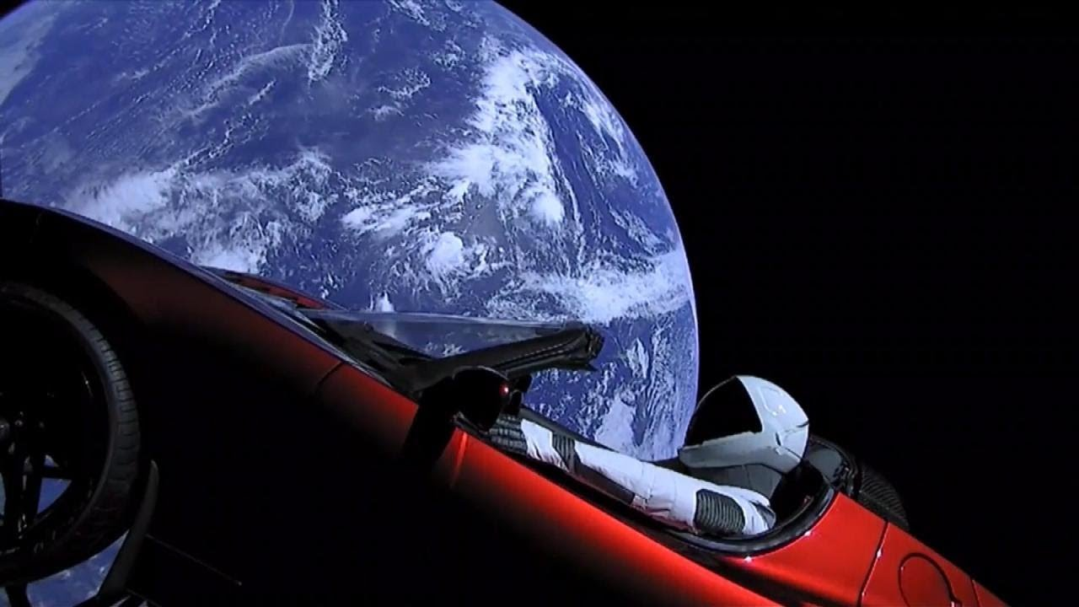
Natural Language Processing: subreddit ‘cars’ vs ‘teslamotors’
By Alex Lau
January 2020

Slide 2

It is time for the world to transition to sustainable energy
Tesla Motors is providing solutions

Slide 3

Transportation Status Quo is Disastrous!
Motor vehicles collectively cause 75 percent of carbon monoxide pollution in the U.S.
Transportation causes 27 percent of greenhouse gas emissions
The U.S. has 30 percent of the world's automobiles, yet it contributes about half of the world's emissions from cars
On-road vehicles cause one-third of the air pollution that produces smog in the U.S.

Slide 4
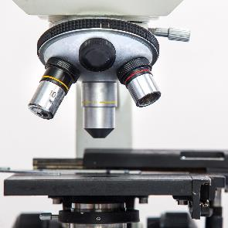

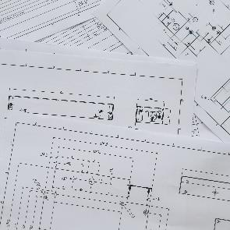



Problem Statement
What key words in titles differentiate users who post on subreddit ‘cars’ versus ‘teslamotors’? How can we leverage this information to influence and educate the population to transition to sustainable energy?
1
2
Goal: Accurately distinguish titles between subreddit ‘cars’ and ‘teslamotors’, and outperform the baseline of 55.45%
Method:
Count Vectorized Logistic Regression
TF-IDF Vectorized Logistic Regression
Multinomial Naïve Bayes Classifier
Gaussian Naïve Bayes Classifier
Success Metrics: Accuracy Scores
3
4
5
6

Slide 5
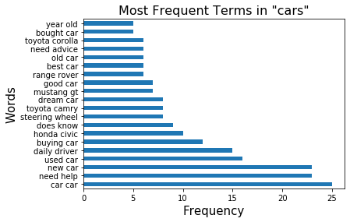
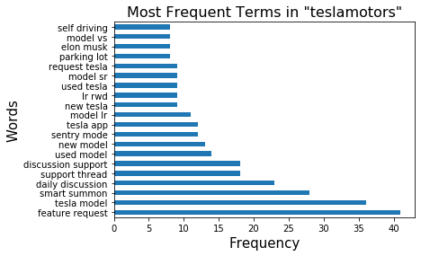
EDA – Classification Bigram Comparisons

Slide 6
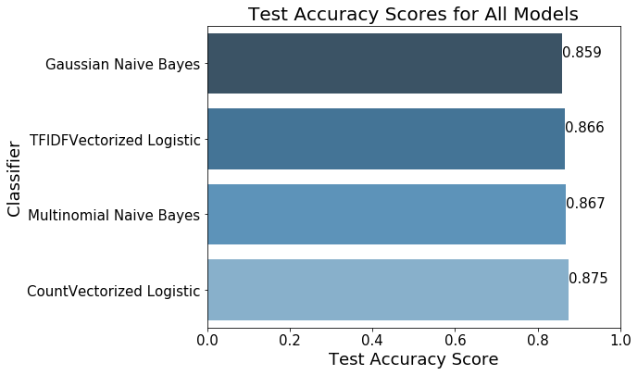
Performance – Count Vectorized Logistic Regression

Slide 7
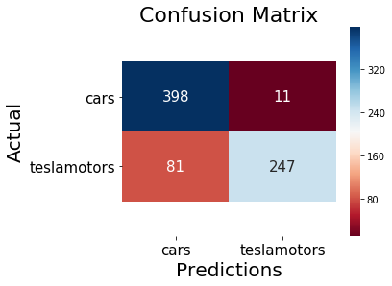
Other Classification Metrics
Accuracy: 87.52%
Recall: 75.30%
Specificity: 97.31%
Precision: 95.74%

Slide 8
Top 10 Words for ‘teslamotors’ Excluding Make and Model
Features | Coefficients | Log-Odds
autopilot | 2.17 | 8.79
v10 | 1.90 | 6.69
summon | 1.82 | 6.17
mode | 1.65 | 5.19
elon | 1.63 | 5.11
deliveri | 1.59 | 4.93
app | 1.42 | 4.16
fsd | 1.41 | 4.11
updat | 1.37 | 3.93
charg | 1.35 | 3.87

Slide 9
Conclusion
Count-Vectorized Logistic Regression
Accuracy score of 87.52% outperforms our baseline of 55.45%
We have identified key words in titles of ‘teslamotors’ that closely relate to the innovations lead by Tesla
Autopilot – A driver assistance safety feature that utilizes cameras, automatic emergency breaking
V10 – Tesla’s biggest software version update that includes
Entertainment interface with Netflix, Hulu, Disney+
Smart Summon that allows the car to drive to you in a parking lot
Spotify interface for individual account access
Summon – The ability to move your car forward and backward with your phone like a remote control
We recommend raising awareness of the life-saving technologies that exist and encourage people to break from the status quo of gas powered vehicles

Slide 10


Resources
Tesla V10 Software: https://www.tesla.com/blog/introducing-software-version-10-0
Car Pollution Statistics: https://auto.howstuffworks.com/air-pollution-from-cars.htm
Alex.lau14@outlook.com

